Slide 1
SSSP with Negative Weights
08 Aug 2025

Slide 2
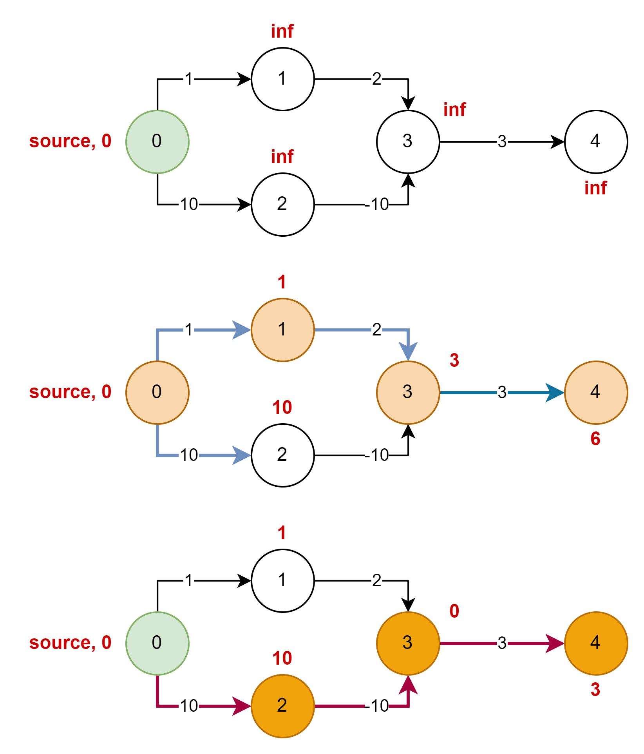
Problem
Initial Graph
Dijkstra fails if a graph has negative edge weights.
Dijkstra algorithm fails due to greedy strategy in the algorithm.
Looks at the example
Dijkstra Solution
Expected Solution

Slide 3
Root Cause of Failure
Dijkstra algorithm fails due to greedy strategy in the algorithm:
Priority queue is root cause of greedy strategy, when it extracts a node with minimum distance at the current moment.
Once node is visited – array visited[], alternatives will not be checked.
Let's take look at the pseudo code of the algorithm – for better understanding.

Slide 4
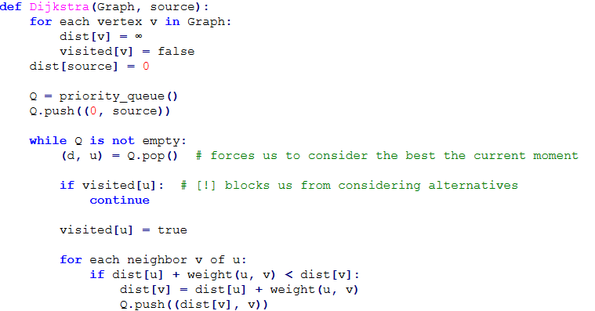
Pseudo-Code of Dijkstra

Slide 5
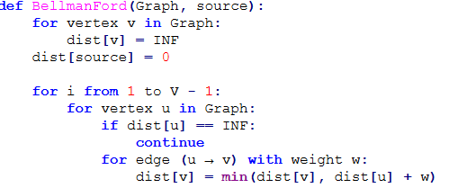
Bellman Ford Algorithm
The algorithm is very simple from code point of view.
Bellman-Ford: O(E * V)
Bellman-Ford: O(V³) if G is matrix
Dijkstra: O((E + V) * log(V))
That’s all! After such run, you have SSSP solution in dist[]

Slide 6
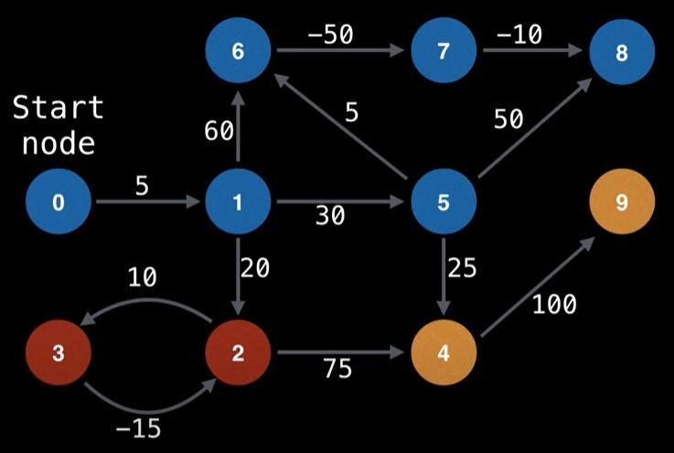
Bellman Ford Algorithm and Negative Cycles
Direct members of negative cycle are: 2 and 3.
Reachable (affected) by negative cycle: 4 and 9.
How to find: just run Bellman Ford algorithm once again and check if distance gets smaller.

Slide 7

Learn by Doing – Haunted Graveyard
Task – Haunted Graveyard – Link.

Slide 8
A Little Fun - Math Puzzles
Multiples of 3 and 5 – Link
Largest Prime Number – Link
Smallest Multiply – Link

